Slide 1
ICS 432 – 01 Distributed and Cloud Computing Fall 2021
Instructor: Thanaa Ghanem
thanaa.ghanem@metrostate.edu
Lecture 2
August 28, 2021

Slide 2
Getting Started with AWS and GCP

Slide 3
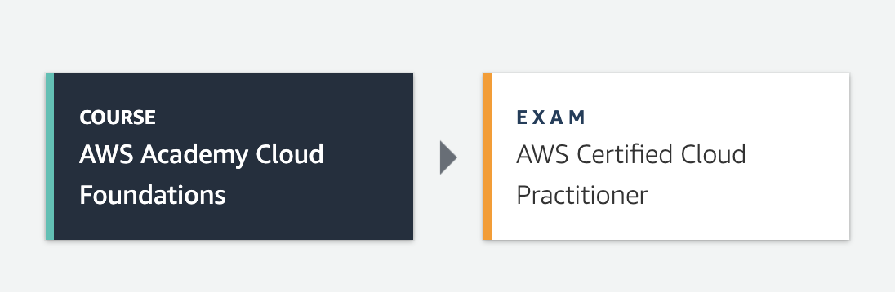
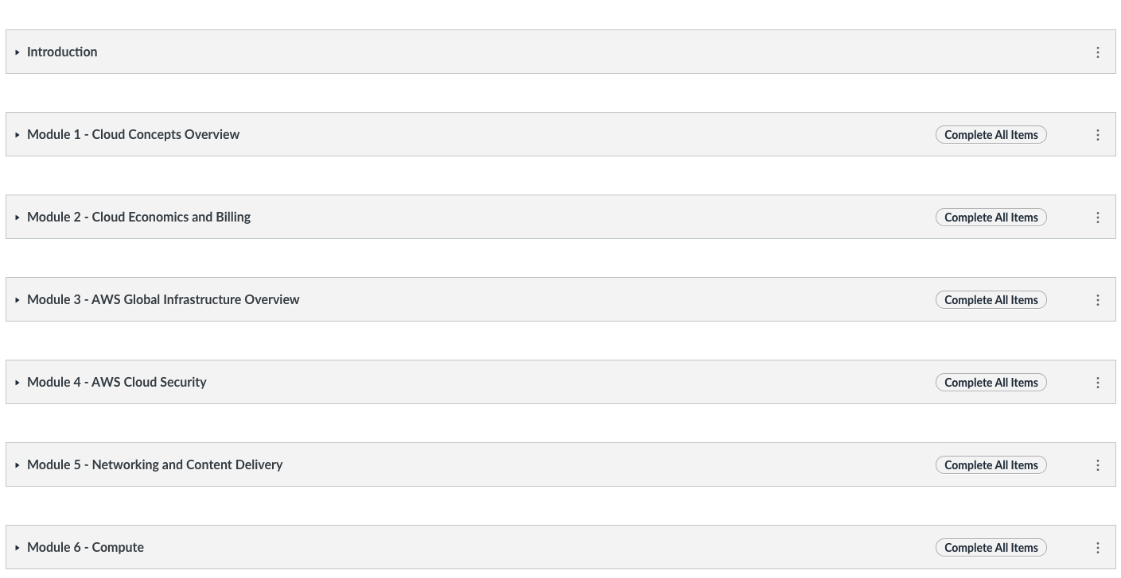
AWS Academy Cloud Foundations Course
Cloud Foundations Course
10 Modules with lab exercises.

Slide 4
Google Cloud Computing Foundations: Cloud Computing Fundamentals
Module 1
Module 2
Module 3
Module 4
Module 5
So, What’s the Cloud Anyway?
Start with a Solid Platform
Use Google Cloud to Build Your Apps
Where Do I Store This Stuff?
There’s an API for That!
Module 6
Module 7
Module 8
Module 9
Module 10
You Can’t Secure the Cloud, Right?
It Helps to Network
Let Google Keep an Eye on Things
You Have the Data, but What Are You Doing with It?
Let Machines Do the Work
Google Cloud skills badges
Register yourself: https://google.qwiklabs.com/course_templates/153
Copyright Google LLC. For educational purposes in accordance with the terms of use set forth on the program Website.

Slide 5
Lecture 2: Getting Started with AWS and GCP
Provider-independent
*Cloud-provider infrastructure
*Cloud Services
*Cloud security:
*Shared responsibility model
*Identity and Access Management ( Cloud IAM)
AWS Cloud Foundations Course
Module 3: AWS Global Infrastructure
*Section 1: AWS Global infrastructure
*Section 2: AWS Services
Module 4: AWS Cloud Security
*Section 1: shared responsibility model
*Section 2: IAM
*Section 5: Securing Data on AWS
*Lab 1: IAM
GCP Cloud Computing Foundations course
Module 2: Start with a solid platform
Module 6: You cannot secure the cloud, right?

Slide 6
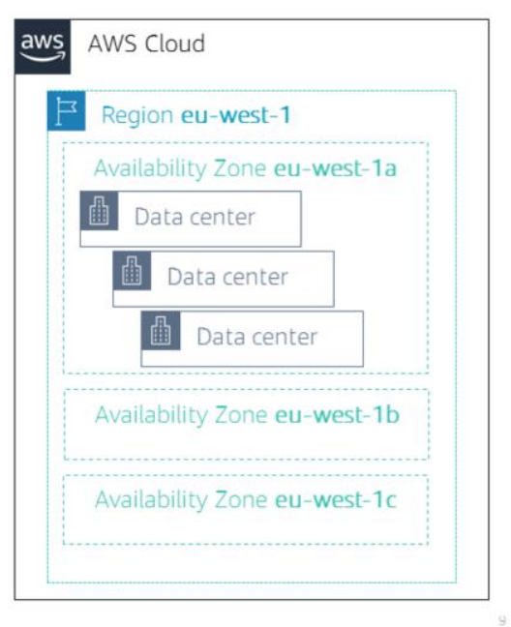
Cloud-provider Infrastructure
Region
Availability Zone
Data Center
Edge locations
Points of Presence (POP)

Slide 7


How a Data Center looks like?
Outside
Inside
Microsoft's datacenters dwarf the small Eastern Washington town of Quincy.
https://www.zdnet.com/article/photos-a-tour-inside-one-of-microsofts-cloud-data-centers/

Slide 8
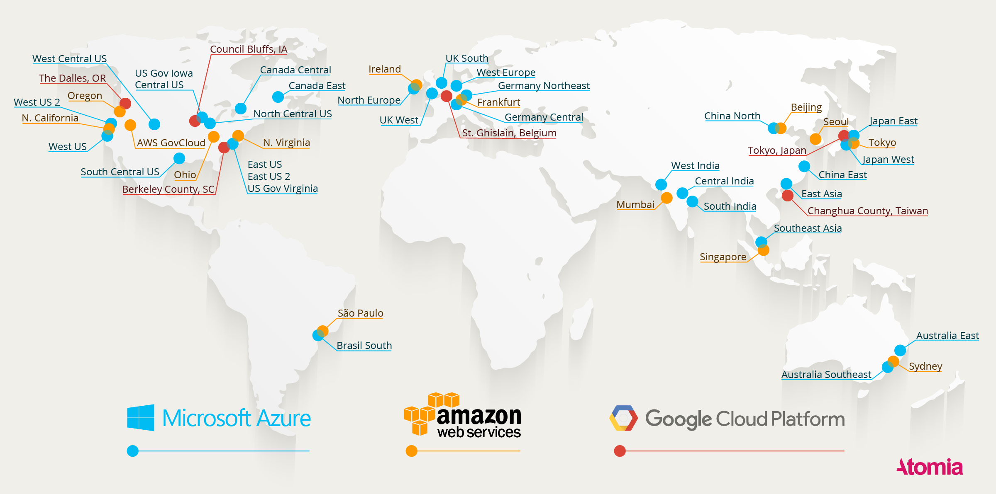
Google, Amazon, and Microsoft Datacenters (as of 2016)
https://www.atomia.com/2016/11/24/comparing-the-geographical-coverage-of-aws-azure-and-google-cloud/
Notes:
https://www.datacenterknowledge.com/archives/2016/09/21/heres-a-map-of-all-azure-and-aws-data-centers

Slide 9
What does a Data Center Look like from inside
Timelapse of a Datacenter Construction on the Inside (Fortune 500 company) (~3 minutes video)
https://www.youtube.com/watch?v=ujO-xNvXj3g
Inside Google’s Data center: (~6 mins video)
https://www.youtube.com/watch?v=XZmGGAbHqa0
Microsoft GFS Datacenter Tour (Youtube) https://www.youtube.com/watch?v=KG4cE362ETE

Slide 10
Cloud-Provider Infrastructure: Definitions
Region: a physical location around the world where we cluster data centers.
AWS: 22 regions, GCP:
Availability Zone (AZ): is one or more discrete data centers with redundant power, networking, and connectivity in a region.
AWS: 69 AZs,
Each AZ (Availability Zone) is completely independent of others which enable them to reside in different areas within the same Region providing a level of Business Continuity in the event of a disaster.
AZs give customers the ability to operate production applications and databases that are more highly available, fault tolerant, and scalable than would be possible from a single data center.

Slide 11
Cloud-Provider Infrastructure Definitions
Points-of-presence (POP) is that specific point where two diverse communication devices or networks meet to establish an electronic association with each other.
AWS: 187 POPs (176 edge locations and 11 Regional edge caches)
Edge locations are data centers designed to deliver services with the lowest latency possible. They're closer to users than Regions or Availability Zones, often in major cities, so responses can be fast and snappy.

Slide 12
Points-of-Presence (POP) vs. Edge Locations
A point of presence can be as simple as “a single server mounted in someone else’s cabinet.”
Edge locations, on the other hand, are points of presence with full deployments of advanced infrastructure—not just a single server.

Slide 13
Cloud Services
Divided into categories:
Foundation services:
Compute
Storage
Networking
Security
Platform services:
Database.
Analytics.
Machine learning and AI.
Developer tools.

Slide 14
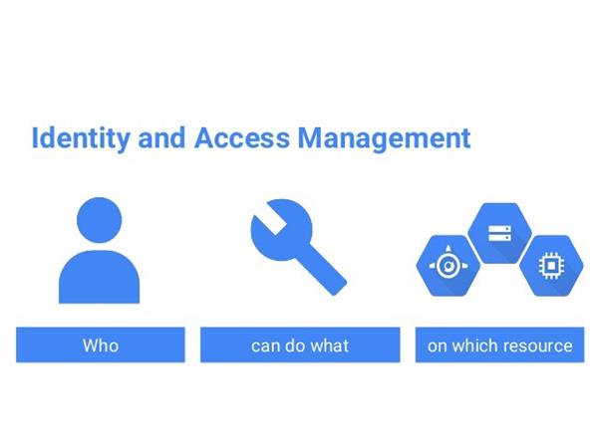
Cloud Security
Shared Responsibility Model is a cloud security framework that dictates the security obligations of a cloud computing provider and its users to ensure accountability.
Identity and Access Management (Cloud IAM)

Slide 15
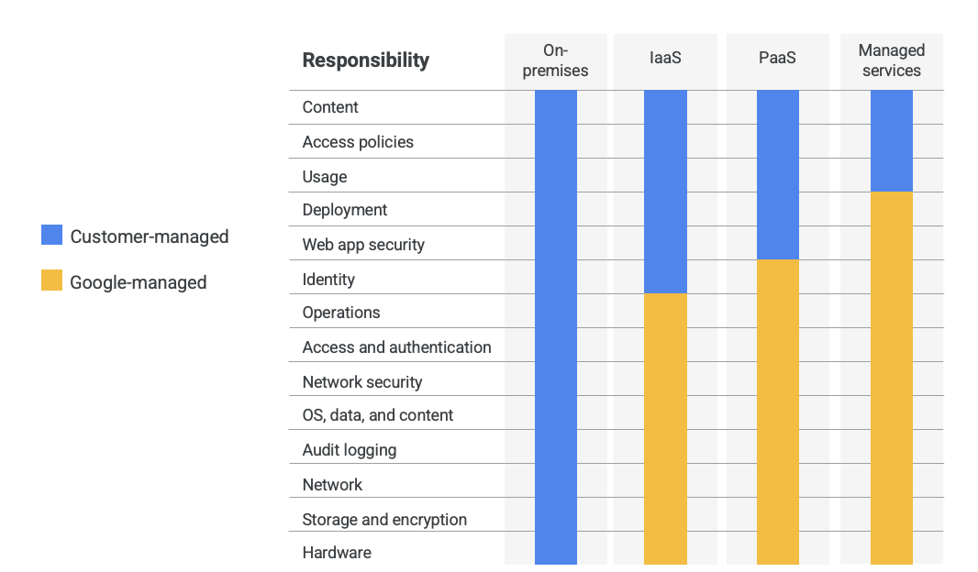
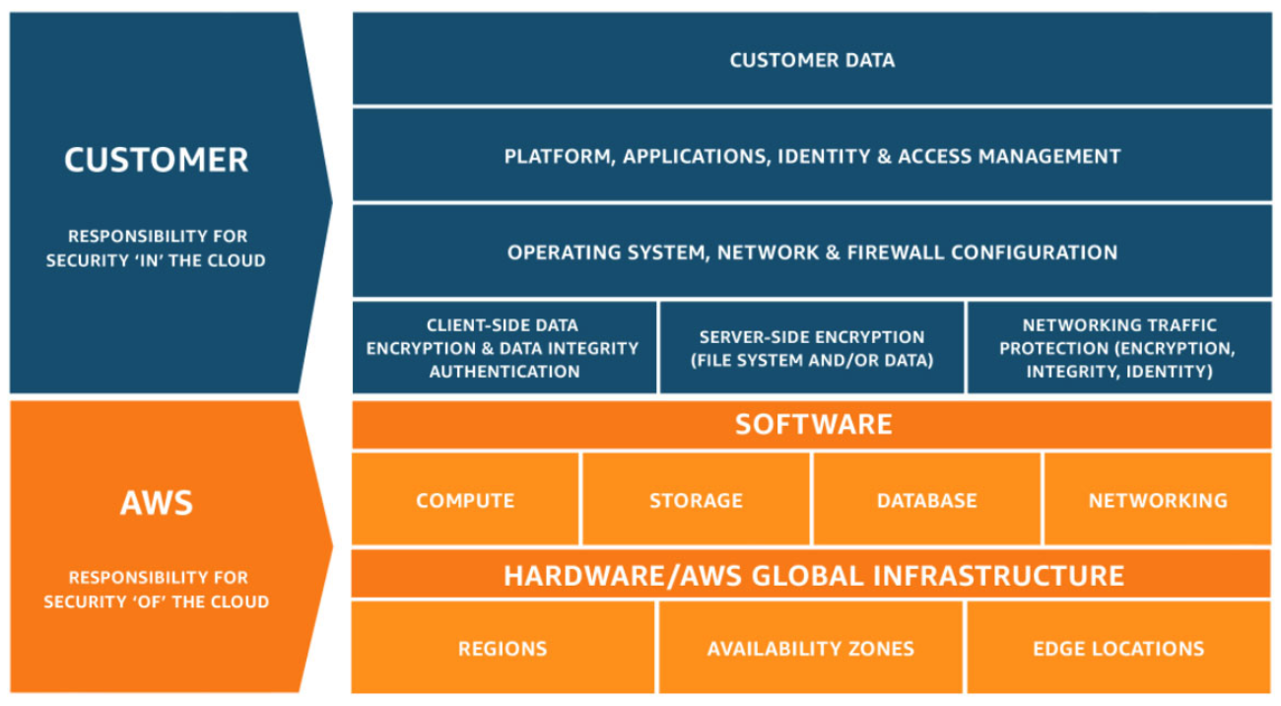
Shared Responsibility Model
GCP
AWS

Slide 16
Identity and Access Management (Cloud IAM)
Define fine-grained access rights –
Who can access the resource
Which resources can be accessed and what can the user do to the resource
How resources can be accessed
Providers differ in their definitions of identity and resource access rights.
AWS: user, group, role, policy
GCP:
who can be google account, service account, google group, or cloud identity.
Predefined roles: owner, editor, viewer, billing administrator

Slide 17
Module 3: AWS Global Infrastructure Overview
AWS Academy Cloud Foundations
© 2019, Amazon Web Services, Inc. or its Affiliates. All rights reserved.
Notes:
Welcome to Module 3: AWS Global Infrastructure Overview.

Slide 18
Module overview
Topics
AWS Global Infrastructure
AWS service and service category overview
Demo
AWS Global Infrastructure
Activities
AWS Management Console clickthrough
Notes:
This module will address the following topics:
AWS Global Infrastructure
AWS service and service category overview
The module includes an educator-led demonstration that focuses on the details of the AWS Global Infrastructure. The module also includes a hands-on activity where you will explore the AWS Management Console.
Finally, you will be asked to complete a knowledge check that will test your understanding of the key concepts that are covered in this module.

Slide 19
Module objectives
After completing this module, you should be able to:
Identify the difference between AWS Regions, Availability Zones, and edge locations
Identify AWS service and service categories
Notes:
After completing this module, you should be able to:
Identify the difference between AWS Regions, Availability Zones, and edge locations
Identify AWS service and service categories

Slide 20
Section 1: AWS Global Infrastructure
Module 3: AWS Global Infrastructure Overview
Notes:
Introducing Section 1: AWS Global Infrastructure.

Slide 21
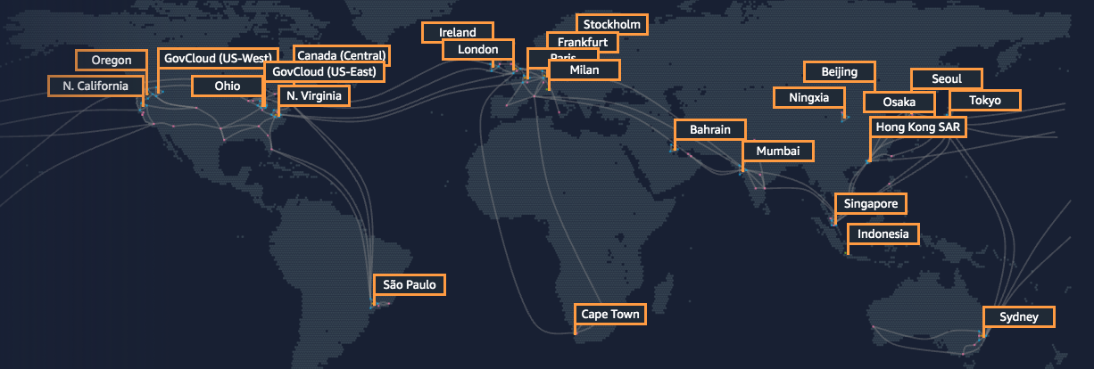
AWS Global Infrastructure
The AWS Global Infrastructure is designed and built to deliver a flexible, reliable, scalable, and secure cloud computing environment with high-quality global network performance.
This map from https://infrastructure.aws shows the current AWS Regions and more that are coming soon.
Notes:
To learn more about the AWS Regions that are currently available, see: https://aws.amazon.com/about-aws/global-infrastructure/.
The diagram shows the 22 current AWS Regions, as well as a few Regions that will become available soon, including Milan, Cape Town, and Indonesia (as of October 2019).

Slide 22
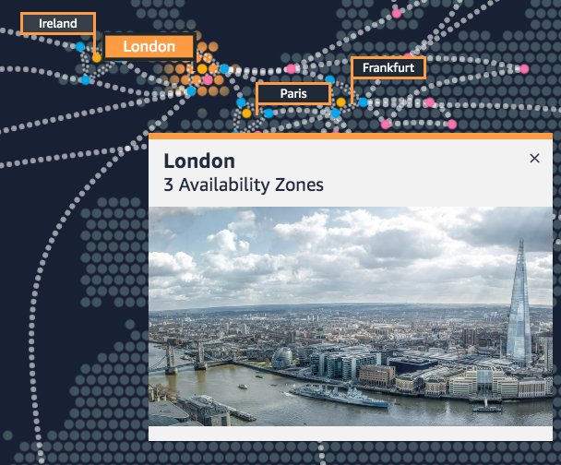
AWS Regions
An AWS Region is a geographical area (22 regions worldwide).
Data replication across Regions is controlled by you.
Communication between Regions uses AWS backbone network infrastructure.
Each Region provides full redundancy and connectivity to the network.
A Region typically consists of two or more Availability Zones.
Example: London Region
Notes:
The AWS Cloud infrastructure is built around Regions. AWS has 22 Regions worldwide. An AWS Region is a physical geographical location with one or more Availability Zones. Availability Zones in turn consist of one or more data centers.
To achieve fault tolerance and stability, Regions are isolated from one another. Resources in one Region are not automatically replicated to other Regions. When you store data in a specific Region, it is not replicated outside that Region.
It is your responsibility to replicate data across Regions, if your business needs require it.
AWS Regions that were introduced before March 20, 2019 are enabled by default. Regions that were introduced after March 20, 2019—such as Asia Pacific (Hong Kong) and Middle East (Bahrain)—are disabled by default. You must enable these Regions before you can use them. You can use the AWS Management Console to enable or disable a Region.
Some Regions have restricted access. An Amazon AWS (China) account provides access to the Beijing and Ningxia Regions only. To learn more about AWS in China, see: https://www.amazonaws.cn/en/about-aws/china/. The isolated AWS GovCloud (US) Region is designed to allow US government agencies and customers to move sensitive workloads into the cloud by addressing their specific regulatory and compliance requirements.

Slide 23
Selecting a Region
Data governance, legal requirements
Proximity to customers (latency)
Determine the right Region for your services, applications, and data based on these factors
Services available within the Region
Costs (vary by Region)
Notes:
There are a few factors that you should consider when you select the optimal Region or Regions where you store data and use AWS services.
One essential consideration is data governance and legal requirements. Local laws might require that certain information be kept within geographical boundaries. Such laws might restrict the Regions where you can offer content or services. For example, consider the European Union (EU) Data Protection Directive.
All else being equal, it is generally desirable to run your applications and store your data in a Region that is as close as possible to the user and systems that will access them. This will help you reduce latency. CloudPing is one website that you can use to test latency between your location and all AWS Regions. To learn more about CloudPing, see: http://www.cloudping.info/
Keep in mind that not all services are available in all Regions. To learn more, see: https://aws.amazon.com/about-aws/global-infrastructure/regional-product-services/?p=tgi&loc=4.
Finally, there is some variation in the cost of running services, which can depend on which Region you choose. For example, as of this writing, running an On-Demand t3.medium size Amazon Elastic Compute Cloud (Amazon EC2) Linux instance in the US East (Ohio) Region costs $0.0416 per hour, but running the same instance in the Asia Pacific (Tokyo) Region costs $0.0544 per hour.

Slide 24



Availability Zones
Each Region has multiple Availability Zones.
Each Availability Zone is a fully isolated partition of the AWS infrastructure.
There are currently 69 Availability Zones worldwide
Availability Zones consist of discrete data centers
They are designed for fault isolation
They are interconnected with other Availability Zones by using high-speed private networking
You choose your Availability Zones.
AWS recommends replicating data and resources across Availability Zones for resiliency.
AWS Cloud
Region eu-west-1
Availability Zone eu-west-1a
Data center
Data center
Data center
Availability Zone eu-west-1b
Availability Zone eu-west-1c
Notes:
Each AWS Region has multiple, isolated locations that are known as Availability Zones.
Each Availability Zone provides the ability to operate applications and databases that are more highly available, fault-tolerant, and scalable than would be possible with a single data center. Each Availability Zone can include multiple data centers (typically three), and at full-scale, they can include hundreds of thousands of servers. They are fully isolated partitions of the AWS Global Infrastructure. Availability Zones have their own power infrastructure, and they are physically separated by many kilometers from other Availability Zones—though all Availability Zones are within 100 km of each other.
All Availability Zones are interconnected with high-bandwidth, low-latency networking over fully redundant, dedicated fiber that provides high-throughput between Availability Zones. The network accomplishes synchronous replication between Availability Zones.
Availability Zones help build highly available applications. When an application is partitioned across Availability Zones, companies are better isolated and protected from issues such as lightning, tornadoes, earthquakes, and more.
You are responsible for selecting the Availability Zones where your systems will reside. Systems can span multiple Availability Zones. AWS recommends replicating across Availability Zones for resiliency. You should design your systems to survive the temporary or prolonged failure of an Availability Zone if a disaster occurs.

Slide 25

AWS data centers
AWS data centers are designed for security.
Data centers are where the data resides and data processing occurs.
Each data center has redundant power, networking, and connectivity, and is housed in a separate facility.
A data center typically has 50,000 to 80,000 physical servers.
Customers do not specify a data center for the deployment of resources. Instead, an Availability Zone is the most granular level of specification that a customer can make.
Notes:
The foundation for the AWS infrastructure is the data centers. Customers do not specify a data center for the deployment of resources. Instead, an Availability Zone is the most granular level of specification that a customer can make. However, a data center is the location where the actual data resides. Amazon operates state-of-the-art, highly available data centers. Although rare, failures can occur that affect the availability of instances in the same location. If you host all your instances in a single location that is affected by such a failure, none of your instances will be available.
AWS uses custom network equipment sourced from multiple original device manufacturers (ODMs). ODMs design and manufacture products based on specifications from a second company. The second company then rebrands the products for sale.

Slide 26
Data centers are securely designed with several factors in mind
Each location is carefully evaluated to mitigate environmental risk.
Data centers have a redundant design that anticipates and tolerates failure while maintaining service levels.
To ensure availability, critical system components are backed up across multiple Availability Zones.
To ensure capacity, AWS continuously monitors service usage to deploy infrastructure to support availability commitments and requirements.
Data center locations are not disclosed and all access to them is restricted.
In case of failure, automated processes move data traffic away from the affected area.

Slide 27
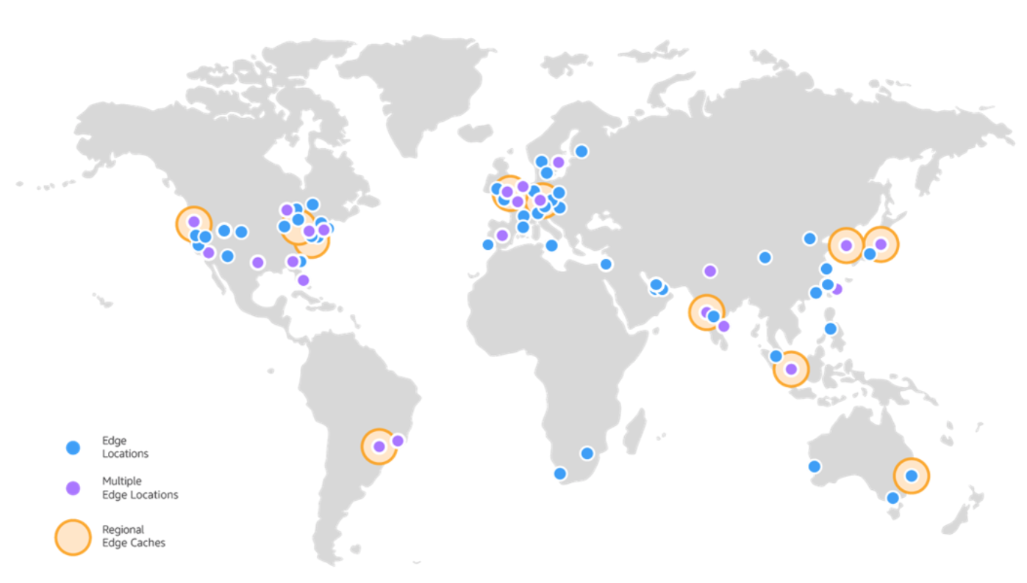
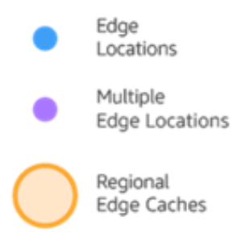
Points of Presence (PoP)
AWS provides a global network of 187 Points of Presence locations
Located in most of the major cities (69 cities in 30 countries)
Consists of 176 edge locations and 11 Regional edge caches
Used with Amazon CloudFront
A global Content Delivery Network (CDN), that delivers content to end users with reduced latency
Regional edge caches used for content with infrequent access.
Notes:
Amazon CloudFront is a content delivery network (CDN) used to distribute content to end users to reduce latency. Amazon Route 53 is a Domain Name System (DNS) service. Requests going to either one of these services will be routed to the nearest edge location automatically in order to lower latency.
AWS Points of Presence are located in most of the major cities (69 cities in total) across 30 countries around the world. By continuously measuring internet connectivity, performance and computing to find the best way to route requests, the Points of Presence deliver a better near real-time user experience. They are used by many AWS services, including Amazon CloudFront, Amazon Route 53, AWS Shield, and AWS Web Application Firewall (AWS WAF) services.
Regional edge caches are used by default with Amazon CloudFront. Regional edge caches are used when you have content that is not accessed frequently enough to remain in an edge location. Regional edge caches absorb this content and provide an alternative to that content having to be fetched from the origin server.

Slide 28




AWS infrastructure features
Elasticity and scalability
Elastic infrastructure; dynamic adaption of capacity
Scalable infrastructure; adapts to accommodate growth
Fault-tolerance
Continues operating properly in the presence of a failure
Built-in redundancy of components
High availability
High level of operational performance
Minimized downtime
No human intervention
Physically distinct
Backup generators
Data center
Data center
Data center
Data center
Data center
Data center
Data center
Data center
Availability Zone
Availability Zone
Network connectivity
Data center
Data center
Data center
Data center
Availability Zone
Uninterruptible power supply
Cooling equipment
AWS Region
Notes:
Now that you have a good understanding of the major components that comprise the AWS Global Infrastructure, let's consider the benefits provided by this infrastructure.
The AWS Global Infrastructure has several valuable features:
First, it is elastic and scalable. This means resources can dynamically adjust to increases or decreases in capacity requirements. It can also rapidly adjust to accommodate growth.
Second, this infrastructure is fault tolerant, which means it has built-in component redundancy which enables it to continue operations despite a failed component.
Finally, it requires minimal to no human intervention, while providing high availability with minimal down time.

Slide 29

Key takeaways
The AWS Global Infrastructure consists of Regions and Availability Zones.
Your choice of a Region is typically based on compliance requirements or to reduce latency.
Each Availability Zone is physically separate from other Availability Zones and has redundant power, networking, and connectivity.
Edge locations, and Regional edge caches improve performance by caching content closer to users.
Notes:
Some key takeaways from this section of the module include:
The AWS Global Infrastructure consists of Regions and Availability Zones.
Your choice of a Region is typically based on compliance requirements or to reduce latency.
Each Availability Zone is physically separate from other Availability Zones and has redundant power, networking, and connectivity.
Edge locations, and Regional edge caches improve performance by caching content closer to users.

Slide 30
Section 2: AWS services and service category overview
Module 3: AWS Global Infrastructure Overview
Notes:
Introducing Part 2: AWS Service and Service Category Overview.
AWS offers a broad set of global cloud-based products that can be used as building blocks for common cloud architectures. Here is a look at how these cloud based products are organized.

Slide 31


AWS foundational services
Applications
Virtual desktops
Collaboration and sharing
Databases
Analytics
Application services
Deployment and management
Mobile Services
Cluster computing
Relational
Queuing
Containers
Identity
Platform Services
Real-time
Orchestration
DevOps tools
Sync
NoSQL
Data warehouse
App Streaming
Resource templates
Mobile Analytics
Transcoding
Email
Usage tracking
Caching
Data workflows
Notifications
Search
Monitoring and logs
Compute (virtual, automatic scaling, and load balancing)
Networking
Storage (object, block, and archive)
Foundation
Services
Infrastructure
Regions
Availability Zones
Edge locations
Notes:
As discussed previously, the AWS Global Infrastructure can be broken down into three elements: Regions, Availability Zones, and Points of Presence, which include edge locations. This infrastructure provides the platform for a broad set of services, such as networking, storage, compute services, and databases—and these services are delivered as an on-demand utility that is available in seconds, with pay-as-you-go pricing.

Slide 32








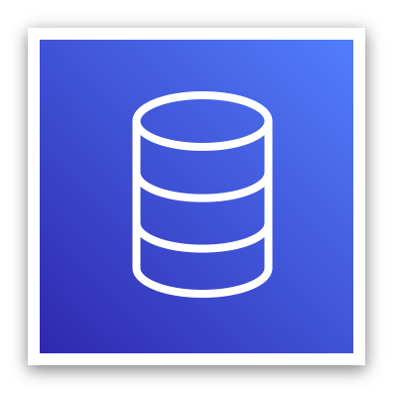

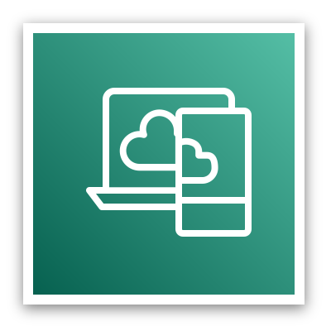







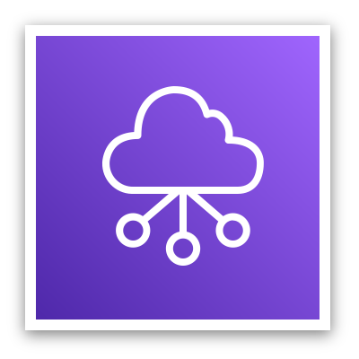



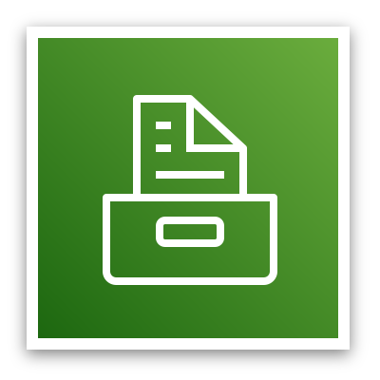
AWS categories of services
Analytics
Application
Integration
AR and VR
Blockchain
Business Applications
Compute
Cost Management
Customer Engagement
Database
Developer Tools
End User
Computing
Game Tech
Internet of Things
Machine Learning
Management and Governance
Media Services
Migration and
Transfer
Mobile
Networking and
Content Delivery
Robotics
Satellite
Security, Identity, and
Compliance
Storage
Notes:
AWS offers a broad set of cloud-based services. There are 23 different product or service categories, and each category consists of one or more services. This course will not attempt to introduce you to each service. Rather, the focus of this course is on the services that are most widely used and offer the best introduction to the AWS Cloud. This course also focuses on services that are more likely to be covered in the AWS Certified Cloud Practitioner exam.
The categories that this course will discuss are highlighted on the slide: Compute, Cost Management, Database, Management and Governance, Networking and Content Delivery, Security, Identity, and Compliance, and Storage.
To learn more about AWS products, see: http://aws.amazon.com/products. All AWS products are organized into the service categories that are shown here. For example, if you click Compute, you will see that Amazon Elastic Compute Cloud (Amazon EC2) is first on the list. The compute category also lists many other products and services.
If you click Amazon EC2, it takes you to the Amazon EC2 page. Each product page provides a detailed description of the product and lists some of its benefits.
Explore the different service groups to understand the categories and services within them. Now that you know how to locate information about different services, this module will discuss the highlighted service categories. The next seven slides list the individual services —within each of the categories highlighted above—that this course will discuss.

Slide 33

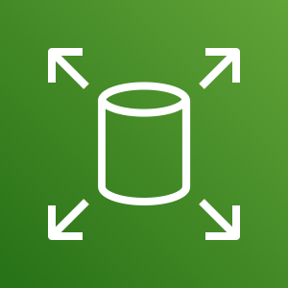
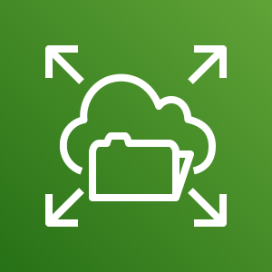

Storage service category
AWS storage services
Amazon Simple Storage Service (Amazon S3)
Amazon Elastic Block Store (Amazon EBS)
Amazon Elastic File System (Amazon EFS)
Photo from https://www.pexels.com/photo/black-and-grey-device-159282/
Amazon Simple Storage Service Glacier
Notes:
AWS storage services include the services listed here, and many others.
Amazon Simple Storage Service (Amazon S3) is an object storage service that offers scalability, data availability, security, and performance. Use it to store and protect any amount of data for websites, mobile apps, backup and restore, archive, enterprise applications, Internet of Things (IoT) devices, and big data analytics.
Amazon Elastic Block Store (Amazon EBS) is high-performance block storage that is designed for use with Amazon EC2 for both throughput and transaction intensive workloads. It is used for a broad range of workloads, such as relational and non-relational databases, enterprise applications, containerized applications, big data analytics engines, file systems, and media workflows.
Amazon Elastic File System (Amazon EFS) provides a scalable, fully managed elastic Network File System (NFS) file system for use with AWS Cloud services and on-premises resources. It is built to scale on demand to petabytes, growing and shrinking automatically as you add and remove files. It reduces the need to provision and manage capacity to accommodate growth.
Amazon Simple Storage Service Glacier is a secure, durable, and extremely low-cost Amazon S3 cloud storage class for data archiving and long-term backup. It is designed to deliver 11 9s of durability, and to provide comprehensive security and compliance capabilities to meet stringent regulatory requirements.

Slide 34





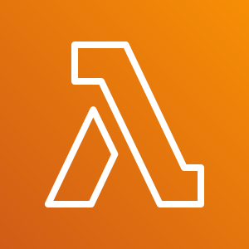
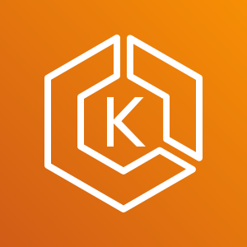
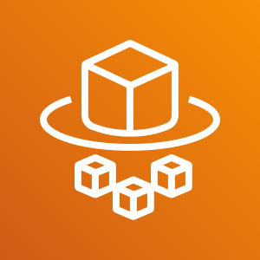
Compute service category
AWS Compute services
Amazon EC2
Amazon EC2 Auto Scaling
Amazon Elastic Container Service (Amazon ECS)
Amazon EC2 Container Registry
Photo from https://www.pexels.com/photo/technology-computer-lines-board-50711/
AWS Elastic Beanstalk
AWS Lambda
Amazon Elastic Kubernetes Service (Amazon EKS)
AWS Fargate
Notes:
AWS compute services include the services listed here, and many others.
Amazon Elastic Compute Cloud (Amazon EC2) provides resizable compute capacity as virtual machines in the cloud.
Amazon EC2 Auto Scaling enables you to automatically add or remove EC2 instances according to conditions that you define.
Amazon Elastic Container Service (Amazon ECS) is a highly scalable, high-performance container orchestration service that supports Docker containers.
Amazon Elastic Container Registry (Amazon ECR) is a fully-managed Docker container registry that makes it easy for developers to store, manage, and deploy Docker container images.
AWS Elastic Beanstalk is a service for deploying and scaling web applications and services on familiar servers such as Apache and Microsoft Internet Information Services (IIS).
AWS Lambda enables you to run code without provisioning or managing servers. You pay only for the compute time that you consume. There is no charge when your code is not running.
Amazon Elastic Kubernetes Service (Amazon EKS) makes it easy to deploy, manage, and scale containerized applications that use Kubernetes on AWS.
AWS Fargate is a compute engine for Amazon ECS that allows you to run containers without having to manage servers or clusters.

Slide 35

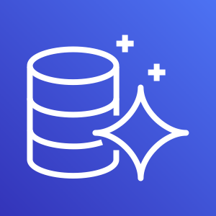


Database service category
AWS Database services
Amazon Relational Database Service
Amazon Aurora
Amazon Redshift
Amazon DynamoDB
Photo from https://aws.amazon.com/compliance/data-center/data-centers/
Notes:
AWS database services include the services listed here, and many others.
Amazon Relational Database Service (Amazon RDS) makes it easy to set up, operate, and scale a relational database in the cloud. It provides resizable capacity while automating time-consuming administration tasks such as hardware provisioning, database setup, patching, and backups.
Amazon Aurora is a MySQL and PostgreSQL-compatible relational database. It is up to five times faster than standard MySQL databases and three times faster than standard PostgreSQL databases.
Amazon Redshift enables you to run analytic queries against petabytes of data that is stored locally in Amazon Redshift, and directly against exabytes of data that are stored in Amazon S3. It delivers fast performance at any scale.
Amazon DynamoDB is a key-value and document database that delivers single-digit millisecond performance at any scale, with built-in security, backup and restore, and in-memory caching.

Slide 36







Networking and content delivery service category
AWS networking and content delivery services
Amazon VPC
Elastic Load Balancing
Amazon CloudFront
AWS Transit
Gateway
Amazon Route 53
AWS Direct Connect
AWS VPN
Photo by Umberto on Unsplash
Notes:
AWS networking and content delivery services include the services listed here, and many others.
Amazon Virtual Private Cloud (Amazon VPC) enables you to provision logically isolated sections of the AWS Cloud.
Elastic Load Balancing automatically distributes incoming application traffic across multiple targets, such as Amazon EC2 instances, containers, IP addresses, and Lambda functions.
Amazon CloudFront is a fast content delivery network (CDN) service that securely delivers data, videos, applications, and application programming interfaces (APIs) to customers globally, with low latency and high transfer speeds.
AWS Transit Gateway is a service that enables customers to connect their Amazon Virtual Private Clouds (VPCs) and their on-premises networks to a single gateway.
Amazon Route 53 is a scalable cloud Domain Name System (DNS) web service designed to give you a reliable way to route end users to internet applications. It translates names (like www.example.com) into the numeric IP addresses (like 192.0.2.1) that computers use to connect to each other.
AWS Direct Connect provides a way to establish a dedicated private network connection from your data center or office to AWS, which can reduce network costs and increase bandwidth throughput.
AWS VPN provides a secure private tunnel from your network or device to the AWS global network.

Slide 37


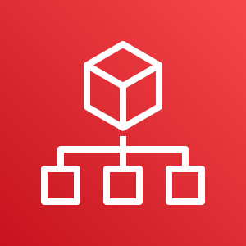

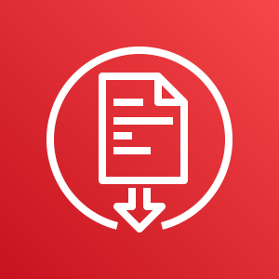


Security, identity, and compliance service category
AWS security, identity, and compliance services
AWS Identity and Access Management (IAM)
AWS Organizations
Amazon Cognito
Photo by Paweł Czerwiński on Unsplash
AWS Artifact
AWS Key
Management Service
AWS Shield
Notes:
AWS security, identity, and compliance services include the services listed here, and many others.
AWS Identity and Access Management (IAM) enables you to manage access to AWS services and resources securely. By using IAM, you can create and manage AWS users and groups. You can use IAM permissions to allow and deny user and group access to AWS resources.
AWS Organizations allows you to restrict what services and actions are allowed in your accounts.
Amazon Cognito lets you add user sign-up, sign-in, and access control to your web and mobile apps.
AWS Artifact provides on-demand access to AWS security and compliance reports and select online agreements.
AWS Key Management Service (AWS KMS) enables you to create and manage keys. You can use AWS KMS to control the use of encryption across a wide range of AWS services and in your applications.
AWS Shield is a managed Distributed Denial of Service (DDoS) protection service that safeguards applications running on AWS.

Slide 38




AWS cost management service category
AWS cost management services
AWS Cost and
Usage Report
AWS Budgets
AWS Cost
Explorer
Photo by Alexander Mils on Unsplash
Notes:
AWS cost management services include the services listed here, and others.
The AWS Cost and Usage Report contains the most comprehensive set of AWS cost and usage data available, including additional metadata about AWS services, pricing, and reservations.
AWS Budgets enables you to set custom budgets that alert you when your costs or usage exceed (or are forecasted to exceed) your budgeted amount.
AWS Cost Explorer has an easy-to-use interface that enables you to visualize, understand, and manage your AWS costs and usage over time.

Slide 39








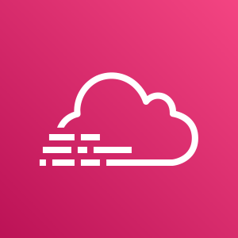
Management and governance service category
AWS management and
governance services
AWS Management Console
AWS Config
Amazon CloudWatch
AWS Auto Scaling
Photo by Marta Branco from Pexels
AWS Command
Line Interface
AWS Trusted
Advisor
AWS Well- Architected Tool
AWS
CloudTrail
Notes:
AWS management and governance services include the services listed here, and others.
The AWS Management Console provides a web-based user interface for accessing your AWS account.
AWS Config provides a service that helps you track resource inventory and changes.
Amazon CloudWatch allows you to monitor resources and applications.
AWS Auto Scaling provides features that allow you to scale multiple resources to meet demand.
AWS Command Line Interface provides a unified tool to manage AWS services.
AWS Trusted Advisor helps you optimize performance and security.
AWS Well-Architected Tool provides help in reviewing and improving your workloads.
AWS CloudTrail tracks user activity and API usage.

Slide 40
Module wrap-up
Module 3: AWS Global Infrastructure Overview
Notes:
It’s now time to review the module and wrap up with a knowledge check and discussion of a practice certification exam question.

Slide 41
Module summary
In summary, in this module you learned how to:
Identify the difference between AWS Regions, Availability Zones, and edge locations
Identify AWS service and service categories
Notes:
In summary, in this module you learned how to:
Identify the difference between AWS Regions, Availability Zones, and edge locations
Identify AWS service and service categories

Slide 42
Additional resources
AWS Global Infrastructure
AWS Global Infrastructure Region Table
AWS Cloud Products
Notes:
The following resources provide more detail on the topics discussed in this module:
AWS Global Infrastructure
AWS Global Infrastructure Region Table
AWS Cloud Products

Slide 43
Module 4: AWS Cloud Security
AWS Academy Cloud Foundations
© 2019, Amazon Web Services, Inc. or its Affiliates. All rights reserved.
Notes:
Welcome to Module 4: AWS Cloud Security.
Security is the highest priority at Amazon Web Services (AWS). AWS delivers a scalable cloud computing environment that is designed for high availability and dependability, while providing the tools that enable you to run a wide range of applications. Helping to protect the confidentiality, integrity, and availability of your systems and data is critical to AWS, and so is maintaining customer trust and confidence. This module provides an introduction to the AWS approach to security, which includes both the controls in the AWS environment and some of the AWS products and features customers can use to meet their security objectives.

Slide 44
Module overview
Topics
AWS shared responsibility model
AWS Identity and Access Management (IAM)
Securing a new AWS account
Securing accounts
Securing data on AWS
Activities
AWS shared responsibility model activity
Demo
Recorded demonstration of IAM
Lab
Introduction to AWS IAM
Notes:
This module will address the following topics:
AWS shared responsibility model
AWS Identity and Access Management (IAM)
Securing a new AWS account
Securing accounts
Securing data on AWS
Working to ensure compliance
Additional security services and resources
Section one includes an educator-led activity on the AWS shared responsibility model.
Section two includes a recorded IAM demo, and the end of this same section there includes a hands-on lab that provides you with practice configuring IAM by using the AWS Management Console.
Finally, you will be asked to complete a knowledge check to test your understanding of the key concepts that are covered in this module.

Slide 45
Module objectives
After completing this module, you should be able to:
Recognize the shared responsibility model
Identify the responsibility of the customer and AWS
Recognize IAM users, groups, and roles
Describe different types of security credentials in IAM
Identify the steps to securing a new AWS account
Explore IAM users and groups
Recognize how to secure AWS data
Recognize AWS compliance programs
Notes:
After completing this module, you should be able to:
Recognize the shared responsibility model
Identify the responsibility of the customer and AWS
Recognize IAM users, groups, and roles
Describe different types of security credentials in IAM
Identify the steps to securing a new AWS account
Explore IAM users and groups
Recognize how to secure AWS data
Recognize AWS compliance programs

Slide 46
Section 1: AWS shared responsibility model
Module 4: AWS Cloud Security
Notes:
Introducing Section 1: AWS shared responsibility model.

Slide 47
AWS shared responsibility model
Notes:
Security and compliance are a shared responsibility between AWS and the customer. This shared responsibility model is designed to help relieve the customer’s operational burden. At the same time, to provide the flexibility and customer control that enables the deployment of customer solutions on AWS, the customer remains responsible for some aspects of the overall security. The differentiation of who is responsible for what is commonly referred to as security “of” the cloud versus security “in” the cloud.
AWS operates, manages, and controls the components from the software virtualization layer down to the physical security of the facilities where AWS services operate. AWS is responsible for protecting the infrastructure that runs all the services that are offered in the AWS Cloud. This infrastructure is composed of the hardware, software, networking, and facilities that run the AWS Cloud services.
The customer is responsible for the encryption of data at rest and data in transit. The customer should also ensure that the network is configured for security and that security credentials and logins are managed safely. Additionally, the customer is responsible for the configuration of security groups and the configuration of the operating system that run on compute instances that they launch (including updates and security patches).

Slide 48


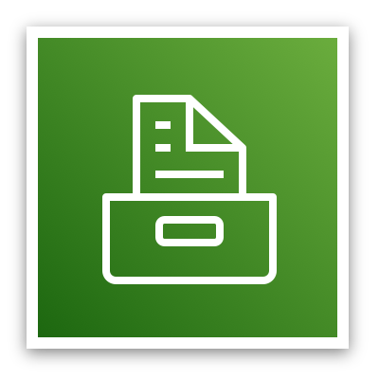
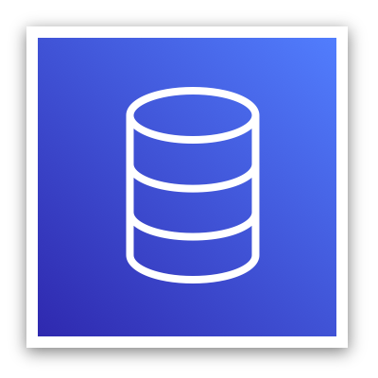
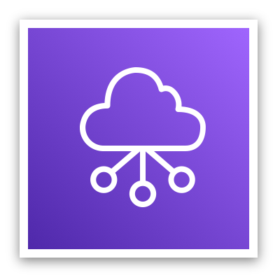


AWS responsibility: Security of the cloud
AWS responsibilities:
Physical security of data centers
Controlled, need-based access
Hardware and software infrastructure
Storage decommissioning, host operating system (OS) access logging, and auditing
Network infrastructure
Intrusion detection
Virtualization infrastructure
Instance isolation
AWS services
Compute
Storage
Database
Networking
AWS Global Infrastructure
Regions
Availability Zones
Edge locations
Notes:
AWS is responsible for security of the cloud. But what does that mean?
Under the AWS shared responsibility model, AWS operates, manages, and controls the components from the bare metal host operating system and hypervisor virtualization layer down to the physical security of the facilities where the services operate. It means that AWS is responsible for protecting the global infrastructure that runs all the services that are offered in the AWS Cloud. The global infrastructure includes AWS Regions, Availability Zones, and edge locations.
AWS is responsible for the physical infrastructure that hosts your resources, including:
Physical security of data centers with controlled, need-based access; located in nondescript facilities, with 24/7 security guards; two-factor authentication; access logging and review; video surveillance; and disk degaussing and destruction.
Hardware infrastructure, such as servers, storage devices, and other appliances that AWS relies on.
Software infrastructure, which hosts operating systems, service applications, and virtualization software.
Network infrastructure, such as routers, switches, load balancers, firewalls, and cabling. AWS also continuously monitors the network at external boundaries, secures access points, and provides redundant infrastructure with intrusion detection.
Protecting this infrastructure is the top priority for AWS. While you cannot visit AWS data centers or offices to see this protection firsthand, Amazon provides several reports from third-party auditors who have verified our compliance with a variety of computer security standards and regulations.

Slide 49
Customer responsibility: Security in the cloud
Customer responsibilities:
Amazon Elastic Compute Cloud (Amazon EC2) instance operating system
Including patching, maintenance
Applications
Passwords, role-based access, etc.
Security group configuration
OS or host-based firewalls
Including intrusion detection or prevention systems
Network configurations
Account management
Login and permission settings for each user
Customer data
Applications, IAM
Operating system, network, and firewall configuration
Client-side data
encryption and data integrity authentication
Server-side encryption
(file system or data)
Network traffic protection
(encryption, integrity, identity)
Customer-configurable
Notes:
While the cloud infrastructure is secured and maintained by AWS, customers are responsible for security of everything they put in the cloud.
The customer is responsible for what is implemented by using AWS services and for the applications that are connected to AWS. The security steps that you must take depend on the services that you use and the complexity of your system.
Customer responsibilities include selecting and securing any instance operating systems, securing the applications that are launched on AWS resources, security group configurations, firewall configurations, network configurations, and secure account management.
When customers use AWS services, they maintain complete control over their content. Customers are responsible for managing critical content security requirements, including:
What content they choose to store on AWS
Which AWS services are used with the content
In what country that content is stored
The format and structure of that content and whether it is masked, anonymized, or encrypted
Who has access to that content and how those access rights are granted, managed, and revoked
Customers retain control of what security they choose to implement to protect their own data, environment, applications, IAM configurations, and operating systems.

Slide 50
Service characteristics and security responsibility
Example services managed by the customer
Infrastructure as a service (IaaS)
Customer has more flexibility over configuring networking and storage settings
Customer is responsible for managing more aspects of the security
Customer configures the access controls
Platform as a service (PaaS)
Customer does not need to manage the underlying infrastructure
AWS handles the operating system, database patching, firewall configuration, and disaster recovery
Customer can focus on managing code or data
Amazon EC2
Amazon Elastic Block Store (Amazon EBS)
Amazon Virtual Private Cloud (Amazon VPC)
Example services managed by AWS
AWS Lambda
Amazon Relational Database Service (Amazon RDS)
AWS Elastic Beanstalk
Notes:
Infrastructure as a service (IaaS) refers to services that provide basic building blocks for cloud IT, typically including access to configure networking, computers (virtual or on dedicated hardware), and data storage space. Cloud services that can be characterized as IaaS provide the customer with the highest level of flexibility and management control over IT resources. IaaS services are most similar to existing on-premises computing resources that many IT departments are familiar with today.
AWS services—such as Amazon EC2—can be categorized as IaaS and thus require the customer to perform all necessary security configuration and management tasks. Customers who deploy EC2 instances are responsible for managing the guest operating system (including updates and security patches), any application software that is installed on the instances, and the configuration of the security groups that were provided by AWS.
Platform as a service (PaaS) refers to services that remove the need for the customer to manage the underlying infrastructure (hardware, operating systems, etc.). PaaS services enable the customer to focus entirely on deploying and managing applications. Customers don’t need to worry about resource procurement, capacity planning, software maintenance, or patching.
AWS services such as AWS Lambda and Amazon RDS can be categorized as PaaS because AWS operates the infrastructure layer, the operating system, and platforms. Customers only need to access the endpoints to store and retrieve data. With PaaS services, customers are responsible for managing their data, classifying their assets, and applying the appropriate permissions. However, these service act more like managed services, with AWS handling a larger portion of the security requirements. For these services, AWS handles basic security tasks—such as operating system and database patching, firewall configuration, and disaster recovery.

Slide 51


Service characteristics and security responsibility (continued)
SaaS examples
Software as a service (SaaS)
Software is centrally hosted
Licensed on a subscription model or pay-as-you-go basis.
Services are typically accessed via web browser, mobile app, or application programming interface (API)
Customers do not need to manage the infrastructure that supports the service
AWS Trusted
Advisor
AWS Shield
Amazon Chime
Notes:
Software as a service (SaaS) refers to services that provide centrally hosted software that is typically accessible via a web browser, mobile app, or application programming interface (API). The licensing model for SaaS offerings is typically subscription or pay as you go. With SaaS offerings, customers do not need to manage the infrastructure that supports the service. Some AWS services—such as AWS Trusted Advisor, AWS Shield, and Amazon Chime—could be categorized as SaaS offerings, given their characteristics.
AWS Trusted Advisor is an online tool that analyzes your AWS environment and provides real-time guidance and recommendations to help you provision your resources by following AWS best practices. The Trusted Advisor service is offered as part of your AWS Support plan. Some of the Trusted Advisor features are free to all accounts, but Business Support and Enterprise Support customers have access to the full set of Trusted Advisor checks and recommendations.
AWS Shield is a managed distributed denial of service (DDoS) protection service that safeguards applications running on AWS. It provides always-on detection and automatic inline mitigations that minimize application downtime and latency, so there is no need to engage AWS Support to benefit from DDoS protection. AWS Shield Advanced is available to all customers. However, to contact the DDoS Response Team, customers must have either Enterprise Support or Business Support from AWS Support.
Amazon Chime is a communications service that enables you to meet, chat, and place business calls inside and outside your organization, all using a single application. It is a pay-as-you-go communications service with no upfront fees, commitments, or long-term contracts.

Slide 52

Activity: AWS shared responsibility model
Photo by Pixabay from Pexels.
Notes:
In this educator-led activity, you will be presented with two scenarios. For each scenario, you will be asked several questions about whose responsibility it is (AWS or the customer) to ensure security of the item in question. The educator will lead the class in a discussion of each question and reveal the correct answers one at a time.

Slide 53


Activity: Scenario 1 of 2
Consider this deployment. Who is responsible – AWS or the customer?
AWS Cloud
Upgrades and patches to the operating system on the EC2 instance?
Physical security of the data center?
Virtualization infrastructure?
EC2 security group settings?
Configuration of applications that run on the EC2 instance?
Oracle upgrades or patches If the Oracle instance runs as an Amazon RDS instance?
Oracle upgrades or patches If Oracle runs on an EC2 instance?
S3 bucket access configuration?
Virtual Private Cloud (VPC)
Amazon Simple Storage Service (Amazon S3)
Amazon EC2
Oracle instance
AWS Global Infrastructure
Notes:
Consider the case where a customer uses the AWS services and resources that are shown here. Who is responsible for maintaining security? AWS or the customer?
The customer uses Amazon Simple Storage Service (Amazon S3) to store data. The customer configured a virtual private cloud (VPC) with Amazon Virtual Private Cloud (Amazon VPC). The EC2 instance and the Oracle database instance that they created both run in the VPC.
In this example, the customer must manage the guest operating system (OS) that runs on the EC2 instance. Over time, the guest OS will need to be upgraded and have security patches applied. Additionally, any application software or utilities that the customer installed on the Amazon EC2 instance must also be maintained. The customer is responsible for configuring the AWS firewall (or security group) that is applied to the Amazon EC2 instance. The customer is also responsible for the VPC configurations that specify the network conditions in which the Amazon EC2 instance runs. These tasks are the same security tasks that IT staff would perform, no matter where their servers are located.
The Oracle instance in this example provides an interesting case study in terms of AWS or customer responsibility. If the database runs on an EC2 instance, then it is the customer's responsibility to apply Oracle software upgrades and patches. However, if the database runs as an Amazon RDS instance, then it is the responsibility of AWS to apply Oracle software upgrades and patches. Because Amazon RDS is a managed database offering, time-consuming database administration tasks—which include provisioning, backups, software patching, monitoring, and hardware scaling—are handled by AWS. To learn more, see Best Practices for Running Oracle Database on AWS for details.

Slide 54






Activity: Scenario 2 of 2
Consider this deployment. Who is responsible – AWS or the customer?
Secure Shell (SSH) keys
Ensuring that the AWS Management Console is not hacked?
Configuring the subnet?
Configuring the VPC?
Protecting against network outages in AWS Regions?
Securing the SSH keys
Ensuring network isolation between AWS customers' data?
Ensuring low-latency network connection between the web server and the S3 bucket?
Enforcing multi-factor authentication for all user logins?
AWS Command Line Interface (AWS CLI)
AWS Management Console
Internet gateway
VPC
Subnet
Web server on Amazon EC2
S3 bucket with objects
Notes:
Now, consider this additional case where a customer uses the AWS services and resources that are shown here. Who is responsible for maintaining security? AWS or the customer?
A customer uses Amazon S3 to store data. The customer configured a virtual private cloud (VPC) with Amazon VPC, and is running a web server on an EC2 instance in the VPC. The customer configured an internet gateway as part of the VPC so that the web server can be reached by using the AWS Management Console or the AWS Command Line Interface (AWS CLI). When the customer uses the AWS CLI, the connection requires the use of Secure Shell (SSH) keys.

Slide 55
Section 1 key takeaways
AWS and the customer share security responsibilities:
AWS is responsible for security of the cloud
Customer is responsible for security in the cloud
AWS is responsible for protecting the infrastructure—including hardware, software, networking, and facilities—that run AWS Cloud services
For services that are categorized as infrastructure as a service (IaaS), the customer is responsible for performing necessary security configuration and management tasks
For example, guest OS updates and security patches, firewall, security group configurations
Notes:
Some key takeaways from this section of the module include:
AWS and the customer share security responsibilities –
AWS is responsible for security of the cloud
Customer is responsible for security in the cloud
AWS is responsible for protecting the infrastructure—including hardware, software, networking, and facilities—that run AWS Cloud services
For services that are categorized as infrastructure as a service (IaaS), the customer is responsible for performing necessary security configuration and management tasks
For example, guest OS updates and security patches, firewall, security group configurations

Slide 56
Section 2: AWS Identity and Access Management (IAM)
Module 4: AWS Cloud Security
Notes:
Introducing Section 2: AWS Identity and Access Management (or IAM).

Slide 57
AWS Identity and Access Management (IAM)
Use IAM to manage access to AWS resources –
A resource is an entity in an AWS account that you can work with
Example resources; An Amazon EC2 instance or an Amazon S3 bucket
Example – Control who can terminate Amazon EC2 instances
Define fine-grained access rights –
Who can access the resource
Which resources can be accessed and what can the user do to the resource
How resources can be accessed
IAM is a no-cost AWS account feature
AWS Identity and Access Management
(IAM)
Notes:
AWS Identity and Access Management (IAM) allows you to control access to compute, storage, database, and application services in the AWS Cloud. IAM can be used to handle authentication, and to specify and enforce authorization policies so that you can specify which users can access which services.
IAM is a tool that centrally manages access to launching, configuring, managing, and terminating resources in your AWS account. It provides granular control over access to resources, including the ability to specify exactly which API calls the user is authorized to make to each service. Whether you use the AWS Management Console, the AWS CLI, or the AWS software development kits (SDKs), every call to an AWS service is an API call.
With IAM, you can manage which resources can be accessed by who, and how these resources can be accessed. You can grant different permissions to different people for different resources. For example, you might allow some users full access to Amazon EC2, Amazon S3, Amazon DynamoDB, Amazon Redshift, and other AWS services. However, for other users, you might allow read-only access to only a few S3 buckets. Similarly, you might grant permission to other users to administer only specific EC2 instances. You could also allow a few users to access only the account billing information, but nothing else.
IAM is a feature of your AWS account, and it is offered at no additional charge.

Slide 58




IAM: Essential components
A person or application that can authenticate with an AWS account.
IAM user
A collection of IAM users that are granted identical authorization.
IAM group
The document that defines which resources can be accessed and the level of access to each resource.
IAM policy
Useful mechanism to grant a set of permissions for making AWS service requests.
IAM role
Notes:
To understand how to use IAM to secure your AWS account, it is important to understand the role and function of each of the four IAM components.
An IAM user is a person or application that is defined in an AWS account, and that must make API calls to AWS products. Each user must have a unique name (with no spaces in the name) within the AWS account, and a set of security credentials that is not shared with other users. These credentials are different from the AWS account root user security credentials. Each user is defined in one and only one AWS account.
An IAM group is a collection of IAM users. You can use IAM groups to simplify specifying and managing permissions for multiple users.
An IAM policy is a document that defines permissions to determine what users can do in the AWS account. A policy typically grants access to specific resources and specifies what the user can do with those resources. Policies can also explicitly deny access.
An IAM role is a tool for granting temporary access to specific AWS resources in an AWS account.

Slide 59
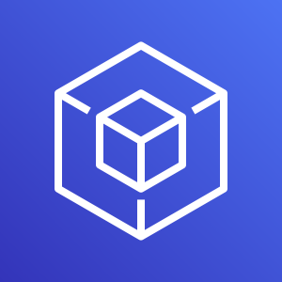
Authenticate as an IAM user to gain access
When you define an IAM user, you select what types of access the user is permitted to use.
Programmatic access
Authenticate using:
Access key ID
Secret access key
Provides AWS CLI and AWS SDK access
AWS Management Console access
Authenticate using:
12-digit Account ID or alias
IAM user name
IAM password
If enabled, multi-factor authentication (MFA) prompts for an authentication code.
AWS CLI
AWS Tools and SDKs
AWS Management Console
Notes:
Authentication is a basic computer security concept: a user or system must first prove their identity. Consider how you authenticate yourself when you go to the airport and you want to get through airport security so that you can catch your flight. In this situation, you must present some form of identification to the security official to prove who you are before you can enter a restricted area. A similar concept applies for gaining access to AWS resources in the cloud.
When you define an IAM user, you select what type of access the user is permitted to use to access AWS resources. You can assign two different types of access to users: programmatic access and AWS Management Console access. You can assign programmatic access only, console access only, or you can assign both types of access.
If you grant programmatic access, the IAM user will be required to present an access key ID and a secret access key when they make an AWS API call by using the AWS CLI, the AWS SDK, or some other development tool.
If you grant AWS Management Console access, the IAM user will be required to fill in the fields that appear in the browser login window. The user is prompted to provide either the 12-digit account ID or the corresponding account alias. The user must also enter their IAM user name and password. If multi-factor authentication (MFA) is enabled for the user, they will also be prompted for an authentication code.

Slide 60

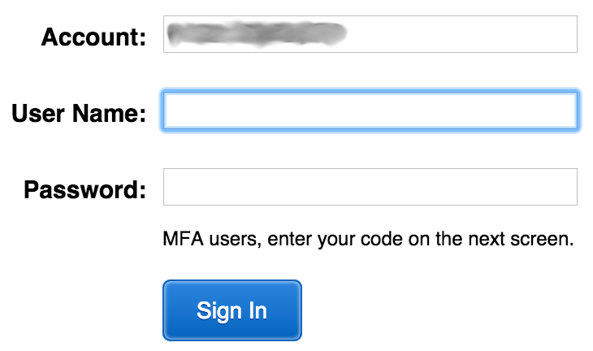

IAM MFA
MFA provides increased security.
In addition to user name and password, MFA requires a unique authentication code to access AWS services.
User name and password
MFA token
AWS Management Console
Notes:
AWS services and resources can be accessed by using the AWS Management Console, the AWS CLI, or through SDKs and APIs. For increased security, we recommend enabling MFA.
With MFA, users and systems must provide an MFA token—in addition to the regular sign-in credentials—before they can access AWS services and resources.
Options for generating the MFA authentication token include virtual MFA-compliant applications (such as Google Authenticator or Authy 2-Factor Authentication), U2F security key devices, and hardware MFA devices.

Slide 61



Authorization: What actions are permitted
After the user or application is connected to the AWS account, what are they allowed to do?
EC2 instances
Full access
Read-only
IAM user, IAM group, or IAM role
S3 bucket
IAM policies
Notes:
Authorization is the process of determining what permissions a user, service or application should be granted. After a user has been authenticated, they must be authorized to access AWS services.
By default, IAM users do not have permissions to access any resources or data in an AWS account. Instead, you must explicitly grant permissions to a user, group, or role by creating a policy, which is a document in JavaScript Object Notation (JSON) format. A policy lists permissions that allow or deny access to resources in the AWS account.

Slide 62
IAM: Authorization
Assign permissions by creating an IAM policy.
Permissions determine which resources and operations are allowed:
All permissions are implicitly denied by default.
If something is explicitly denied, it is never allowed.
Best practice: Follow the principle of least privilege.
Note: The scope of IAM service configurations is global. Settings apply across all AWS Regions.
IAM permissions
Notes:
To assign permission to a user, group or role, you must create an IAM policy (or find an existing policy in the account). There are no default permissions. All actions in the account are denied to the user by default (implicit deny) unless those actions are explicitly allowed. Any actions that you do not explicitly allow are denied. Any actions that you explicitly deny are always denied.
The principle of least privilege is an important concept in computer security. It promotes that you grant only the minimal user privileges needed to the user, based on the needs of your users. When you create IAM policies, it is a best practice to follow this security advice of granting least privilege. Determine what users need to be able to do and then craft policies for them that let the users perform only those tasks. Start with a minimum set of permissions and grant additional permissions as necessary. Doing so is more secure than starting with permissions that are too broad and then later trying to lock down the permissions granted.
Note that the scope of the IAM service configurations is global. The settings are not defined at an AWS Region level. IAM settings apply across all AWS Regions.

Slide 63
IAM policies
An IAM policy is a document that defines permissions
Enables fine-grained access control
Two types of policies – identity-based and resource-based
Identity-based policies –
Attach a policy to any IAM entity
An IAM user, an IAM group, or an IAM role
Policies specify:
Actions that may be performed by the entity
Actions that may not be performed by the entity
A single policy can be attached to multiple entities
A single entity can have multiple policies attached to it
Resource-based policies
Attached to a resource (such as an S3 bucket)
IAM entities
Attach to one of
IAM user
IAM policy
IAM group
IAM role
Notes:
An IAM policy is a formal statement of permissions that will be granted to an entity. Policies can be attached to any IAM entity. Entities include users, groups, roles, or resources. For example, you can attach a policy to AWS resources that will block all requests that do not come from an approved Internet Protocol (IP) address range. Policies specify what actions are allowed, which resources to allow the actions on, and what the effect will be when the user requests access to the resources.
The order in which the policies are evaluated has no effect on the outcome of the evaluation. All policies are evaluated, and the result is always that the request is either allowed or denied. When there is a conflict, the most restrictive policy applies.
There are two types of IAM policies. Identity-based policies are permissions policies that you can attach to a principal (or identity) such as an IAM user, role, or group. These policies control what actions that identity can perform, on which resources, and under what conditions. Identity-based policies can be further categorized as:
Managed policies – Standalone identity-based policies that you can attach to multiple users, groups, and roles in your AWS account
Inline policies – Policies that you create and manage, and that are embedded directly into a single user group or role.
Resource-based policies are JSON policy documents that you attach to a resource, such as an S3 bucket. These policies control what actions a specified principal can perform on that resource, and under what conditions.

Slide 64

IAM policy example
{
"Version": "2012-10-17",
"Statement":[{
"Effect":"Allow",
"Action":["DynamoDB:*","s3:*"],
"Resource":[ "arn:aws:dynamodb:region:account-number-without-hyphens:table/table-name",
"arn:aws:s3:::bucket-name",
"arn:aws:s3:::bucket-name/*"]
},
{
"Effect":"Deny",
"Action":["dynamodb:*","s3:*"],
"NotResource":["arn:aws:dynamodb:region:account-number-without-hyphens:table/table-name”,
"arn:aws:s3:::bucket-name",
"arn:aws:s3:::bucket-name/*"]
}
]
}
Explicit allow gives users access to a specific DynamoDB table and…
…Amazon S3 buckets.
Explicit deny ensures that the users cannot use any other AWS actions or resources other than that table and those buckets.
An explicit deny statement takes precedence over an allow statement.
Notes:
As mentioned previously, IAM policy documents are written in JSON.
The example IAM policy grants users access only to the following resources:
The DynamoDB table whose name is represented by table-name.
The AWS account's S3 bucket, whose name is represented by bucket-name and all the objects that it contains.
The IAM policy also includes an explicit deny ("Effect":"Deny") element. The NotResource element helps to ensure that users cannot use any other DynamoDB or S3 actions or resources except the actions and resources that are specified in the policy—even if permissions have been granted in another policy. An explicit deny statement takes precedence over an allow statement.

Slide 65


Resource-based policies
Identity-based policies are attached to a user, group, or role
Resource-based policies are attached to a resource (not to a user, group or role)
Characteristics of resource-based policies –
Specifies who has access to the resource and what actions they can perform on it
The policies are inline only, not managed
Resource-based policies are supported only by some AWS services
AWS Account
IAM user MaryMajor
S3 bucket photos
attached
Defined inline
on the bucket
Identity-based policy
Resource-based policy
Policy grants list, read objects to the photos bucket
Policy grants user MaryMajor list, read objects
Notes:
While identity-based policies are attached to a user, group, or role, resource-based policies are attached to a resource, such as an S3 bucket. These policies specify who can access the resource and what actions they can perform on it.
Resource-based policies are defined inline only, which means that you define the policy on the resource itself, instead of creating a separate IAM policy document that you attach. For example, to create an S3 bucket policy (a type of resource-based policy) on an S3 bucket, navigate to the bucket, click the Permissions tab, click the Bucket Policy button, and define the JSON-formatted policy document there. An Amazon S3 access control list (ACL) is another example of a resource-based policy.
The diagram shows two different ways that the user MaryMajor could be granted access to objects in the S3 bucket that is named photos. On the left, you see an example of an identity-based policy. An IAM policy that grants access to the S3 bucket is attached to the MaryMajor user. On the right, you see an example of a resource-based policy. The S3 bucket policy for the photos bucket specifies that the user MaryMajor is allowed to list and read the objects in the bucket.
Note that you could define a deny statement in a bucket policy to restrict access to specific IAM users, even if the users are granted access in a separate identity-based policy. An explicit deny statement will always take precedence over any allow statement.

Slide 66
IAM permissions
How IAM determines permissions:
Is the permission explicitly denied ?
Is the permission explicitly allowed ?
No
No
Deny
Implicit deny
Yes
Yes
Deny
Allow
Notes:
IAM policies enable you to fine-tune privileges that are granted to IAM users, groups, and roles.
When IAM determines whether a permission is allowed, IAM first checks for the existence of any applicable explicit denial policy. If no explicit denial exists, it then checks for any applicable explicit allow policy. If neither an explicit deny nor an explicit allow policy exists, IAM reverts to the default, which is to deny access. This process is referred to as an implicit deny. The user will be permitted to take the action only if the requested action is not explicitly denied and is explicitly allowed.
It can be difficult to figure out whether access to a resource will be granted to an IAM entity when you develop IAM policies. The IAM Policy Simulator is a useful tool for testing and troubleshooting IAM policies.

Slide 67
IAM groups
An IAM group is a collection of IAM users
A group is used to grant the same permissions to multiple users
Permissions granted by attaching IAM policy or policies to the group
A user can belong to multiple groups
There is no default group
Groups cannot be nested
AWS account
IAM group:
Admins
IAM group:
Developers
IAM group:
Testers
Carlos Salazar
Li Juan
Zhang Wei
Márcia Oliveira
Mary Major
John Stiles
Richard Roe
Li Juan
Notes:
An IAM group is a collection of IAM users. IAM groups offer a convenient way to specify permissions for a collection of users, which can make it easier to manage the permissions for those users.
For example, you could create an IAM group that is called Developers and attach an IAM policy or multiple IAM policies to the Developers group that grant the AWS resource access permissions that developers typically need. Any user that you then add to the Developer group will automatically have the permissions that are assigned to the group. In such a case, you do not need to attach the IAM policy or IAM policies directly to the user. If a new user joins your organization and should be granted developer privileges, you can simply add that user to the Developers group. Similarly, if a person changes jobs in your organization, instead of editing that user's permissions, simply remove the user from the group.
Important characteristics of IAM groups:
A group can contain many users, and a user can belong to multiple groups.
Groups cannot be nested. A group can contain only users, and a group cannot contain other groups.
There is no default group that automatically includes all users in the AWS account. If you want to have a group with all account users in it, you need to create the group and add each new user to it.

Slide 68
IAM roles
An IAM role is an IAM identity with specific permissions
Similar to an IAM user
Attach permissions policies to it
Different from an IAM user
Not uniquely associated with one person
Intended to be assumable by a person, application, or service
Role provides temporary security credentials
Examples of how IAM roles are used to delegate access –
Used by an IAM user in the same AWS account as the role
Used by an AWS service—such as Amazon EC2—in the same account as the role
Used by an IAM user in a different AWS account than the role
IAM role
Notes:
An IAM role is an IAM identity you can create in your account that has specific permissions. An IAM role is similar to an IAM user because it is also an AWS identity that you can attach permissions policies to, and those permissions determine what the identity can and cannot do in AWS. However, instead of being uniquely associated with one person, a role is intended to be assumable by anyone who needs it. Also, a role does not have standard long-term credentials such as a password or access keys associated with it. Instead, when you assume a role, the role provides you with temporary security credentials for your role session.
You can use roles to delegate access to users, applications, or services that do not normally have access to your AWS resources. For example, you might want to grant users in your AWS account access to resources they don't usually have, or grant users in one AWS account access to resources in another account. Or you might want to allow a mobile app to use AWS resources, but you do not want to embed AWS keys within the app (where the keys can be difficult to rotate and where users can potentially extract them and misuse them). Also, sometimes you may want to grant AWS access to users who already have identities that are defined outside of AWS, such as in your corporate directory. Or, you might want to grant access to your account to third parties so that they can perform an audit on your resources.
For all of these example use cases, IAM roles are an essential component to implementing the cloud deployment.

Slide 69


Example use of an IAM role
Scenario:
An application that runs on an EC2 instance needs access to an S3 bucket
Solution:
Define an IAM policy that grants access to the S3 bucket.
Attach the policy to a role
Allow the EC2 instance to assume the role
AWS Cloud
Application has permissions to access the S3 bucket
Amazon EC2 instance
Application
3
Amazon S3 bucket photos
Role assumed by the EC2 instance
2
attached
IAM role
1
IAM policy grants access to photos bucket
Notes:
In the diagram, a developer runs an application on an EC2 instance that requires access to the S3 bucket that is named photos. An administrator creates the IAM role and attaches the role to the EC2 instance. The role includes a permissions policy that grants read-only access to the specified S3 bucket. It also includes a trust policy that allows the EC2 instance to assume the role and retrieve the temporary credentials. When the application runs on the instance, it can use the role's temporary credentials to access the photos bucket. The administrator does not need to grant the application developer permission to access the photos bucket, and the developer never needs to share or manage credentials.
To learn more details about this example, see Using an IAM Role to Grant Permissions to Applications Running on Amazon EC2 Instances.

Slide 70
Section 2 key takeaways
IAM policies are constructed with JavaScript Object Notation (JSON) and define permissions.
IAM policies can be attached to any IAM entity.
Entities are IAM users, IAM groups, and IAM roles.
An IAM user provides a way for a person, application, or service to authenticate to AWS.
An IAM group is a simple way to attach the same policies to multiple users.
An IAM role can have permissions policies attached to it, and can be used to delegate temporary access to users or applications.
Notes:
Some key takeaways from this section of the module include:
IAM policies are constructed with JavaScript Object Notation (JSON) and define permissions.
IAM policies can be attached to any IAM entity.
Entities are IAM users, IAM groups, and IAM roles.
An IAM user provides a way for a person, application, or service to authenticate to AWS.
An IAM group is a simple way to attach the same policies to multiple users.
An IAM role can have permissions policies attached to it, and can be used to delegate temporary access to users or applications.

Slide 71
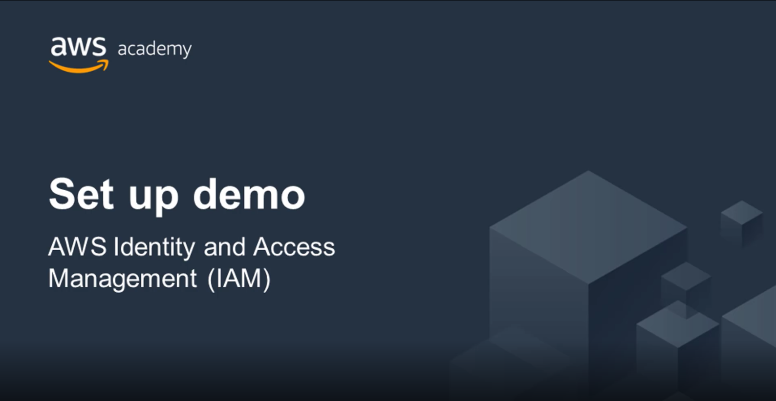
Recorded demo: IAM
Notes:
Now, take a moment to watch the IAM Demo. The recording runs a little over 4 minutes, and it reinforces many of the concepts that were discussed in this section of the module.
The demonstration shows how to configure the following resources by using the AWS Management Console:
An IAM role that will be used by an EC2 instance
An IAM group
An IAM user

Slide 72
ICS 432 Lab 1: Exercise 2: AWS Academy course Module 4 - Lab 1
Task 1: Explore the Users and Groups.
Task 2: Add Users to Groups.
Task 3: Sign-In and Test Users.
AWS Identity and Access Management (IAM)
Notes:
In this hands-on lab, you will:
Explore pre-created IAM users and groups.
Inspect IAM policies as they are applied to the pre-created groups.
Follow a real-world scenario and add users to groups that have specific capabilities enabled.
Locate and use the IAM sign-in URL.
Experiment with the effects of IAM policies on access to AWS resources.

Slide 73
Lab 1: Final product
Account
AWS account
Users
Groups
user-1
user-2
user-3
EC2-Admin
EC2-Support
S3-Support
user-2
Amazon EC2 read-only access
Amazon EC2 – View, start, and stop access
IAM inline policy
IAM managed policy S3 read-only access
user-3
user-1
Notes:
The diagram shows the resources that your AWS account will have after you complete the lab steps. It also describes how the resources will be configured.

Slide 74
Section 5: Securing data on AWS
Module 4: AWS Cloud Security
Notes:
Introducing Section 5: Securing data on AWS

Slide 75




Encryption of data at rest
Encryption encodes data with a secret key, which makes it unreadable
Only those who have the secret key can decode the data
AWS KMS can manage your secret keys
using the open standard Advanced Encryption Standard (AES)-256 encryption algorithm.
AWS supports encryption of data at rest
Data at rest = Data stored physically (on disk or on tape)
You can encrypt data stored in any service that is supported by AWS KMS, including:
Amazon S3
Amazon EBS
Amazon Elastic File System (Amazon EFS)
Amazon RDS managed databases
Encrypt your data using the open standard Advanced Encryption Standard (AES)-256 encryption algorithm.
Notes:
Data encryption is an essential tool to use when your objective is to protect digital data. Data encryption takes data that is legible and encodes it so that it is unreadable to anyone who does not have access to the secret key that can be used to decode it. Thus, even if an attacker gains access to your data, they cannot make sense of it.
Data at rest refers to data that is physically stored on disk or on tape.
You can create encrypted file systems on AWS so that all your data and metadata is encrypted at rest by using the open standard Advanced Encryption Standard (AES)-256 encryption algorithm. When you use AWS KMS, encryption and decryption are handled automatically and transparently, so that you do not need to modify your applications. If your organization is subject to corporate or regulatory policies that require encryption of data and metadata at rest, AWS recommends enabling encryption on all services that store your data. You can encrypt data stored in any service that is supported by AWS KMS. See How AWS Services use AWS KMS for a list of supported services.

Slide 76



Encryption of data in transit
Encryption of data in transit (data moving across a network)
Transport Layer Security (TLS)—formerly SSL—is an open standard protocol
AWS Certificate Manager provides a way to manage, deploy, and renew TLS or SSL certificates
Secure HTTP (HTTPS) creates a secure tunnel
Uses TLS or SSL for the bidirectional exchange of data
AWS services support data in transit encryption.
Two examples:
AWS Cloud
Corporate data center
AWS Cloud
TLS encrypted data traffic
TLS or SSL
encrypted
Amazon EC2
Amazon EFS
AWS Storage Gateway
Amazon S3
Notes:
Data in transit refers to data that is moving across the network. Encryption of data in transit is accomplished by using Transport Layer Security (TLS) 1.2 with an open standard AES-256 cipher. TLS was formerly called Secure Sockets Layer (SSL).
AWS Certificate Manager is a service that enables you to provision, manage, and deploy SSL or TLS certificates for use with AWS services and your internal connected resources. SSL or TLS certificates are used to secure network communications and establish the identity of websites over the internet, and also resources on private networks. With AWS Certificate Manager, you can request a certificate and then deploy it on AWS resources (such as load balancers or CloudFront distributions). AWS Certificate Manager also handles certificate renewals.
Web traffic that runs over HTTP is not secure. However, traffic that runs over Secure HTTP (HTTPS) is encrypted by using TLS or SSL. HTTPS traffic is protected against eavesdropping and man-in-the-middle attacks because of the bidirectional encryption of the communication.
AWS services support encryption for data in transit. Two examples of encryption for data in transit are shown. The first example shows an EC2 instance that has mounted an Amazon EFS shared file system. All data traffic between the instance and Amazon EFS is encrypted by using TLS or SSL. For further details about this configuration, see Encryption of EFS Data in Transit.
The second example shows the use of AWS Storage Gateway, a hybrid cloud storage service that provides on-premises access to AWS Cloud storage. In this example, the storage gateway is connected across the internet to Amazon S3, and the connection encrypts the data in transit.

Slide 77
Securing Amazon S3 buckets and objects
Newly created S3 buckets and objects are private and protected by default.
When use cases require sharing data objects on Amazon S3 –
It is essential to manage and control the data access.
Follow the permissions that follow the principle of least privilege and consider using Amazon S3 encryption.
Tools and options for controlling access to S3 data include –
Amazon S3 Block Public Access feature: Simple to use.
IAM policies: A good option when the user can authenticate using IAM.
Bucket policies
Access control lists (ACLs): A legacy access control mechanism.
AWS Trusted Advisor bucket permission check: A free feature.
Notes:
By default, all Amazon S3 buckets are private and can be accessed only by users who are explicitly granted access. It is essential to manage and control access to Amazon S3 data. AWS provides many tools and options for controlling access to your S3 buckets or objects, including:
Using Amazon S3 Block Public Access. These settings override any other policies or object permissions. Enable Block Public Access for all buckets that you don't want to be publicly accessible. This feature provides a straightforward method for avoiding unintended exposure of Amazon S3 data.
Writing IAM policies that specify the users or roles that can access specific buckets and objects. This method was discussed in detail earlier in this module.
Writing bucket policies that define access to specific buckets or objects. This option is typically used when the user or system cannot authenticate by using IAM. Bucket policies can be configured to grant access across AWS accounts or to grant public or anonymous access to Amazon S3 data. If bucket policies are used, they should be written carefully and tested fully. You can specify a deny statement in a bucket policy to restrict access. Access will be restricted even if the users have permissions that are granted in an identity-based policy that is attached to the users.
Setting access control lists (ACLs) on your buckets and objects. ACLs are less commonly used (ACLs predate IAM). If you do use ACLs, do not set access that is too open or permissive.
AWS Trusted Advisor provides a bucket permission check feature that is a useful tool for discovering if any of the buckets in your account have permissions that grant global access.

